Slide 1



Heart monitor with Arduino
Miguel Ángel Pancha
Erick Duque
Valentina Rozo
Group N:3

Slide 2
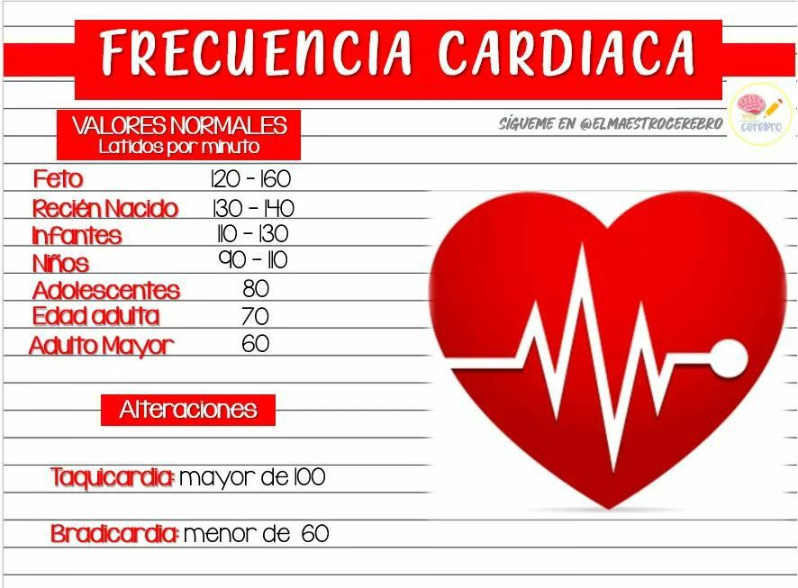

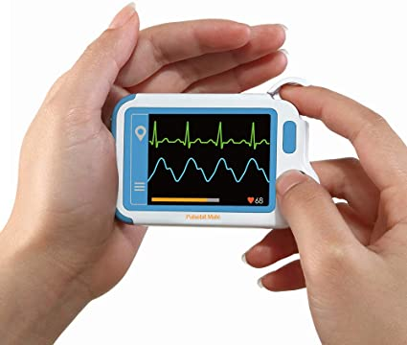
context
Tomado de: https://www.amazon.com/-/es/card%C3%ADaco-personal-software-dispositivo-supervisi%C3%B3n/dp/B0863J2P3D
Tomado de: https://co.pinterest.com/pin/826410600364017524/
Tomado de: https://www.marathonranking.com/noticias-sobre-maraton/el-gran-peligro-de-alcanzar-la-frecuencia-cardiaca-maxima-al-correr/

Slide 3
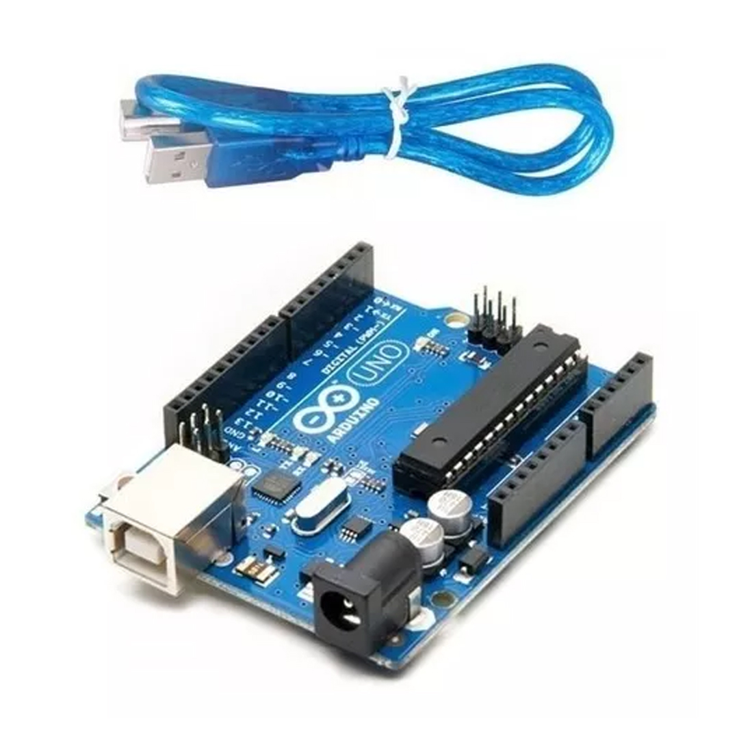
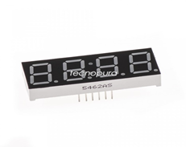
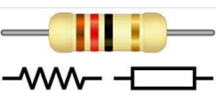
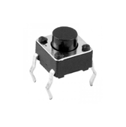
materials and connections
Resistor
Arduino uno:
Display 7 segments of 4 digits
Push botton

Slide 4
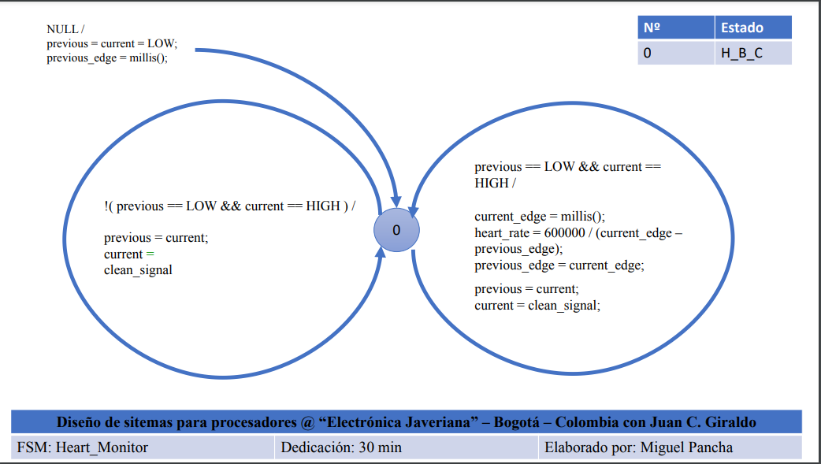
Heart monitor Diagrams

Slide 5
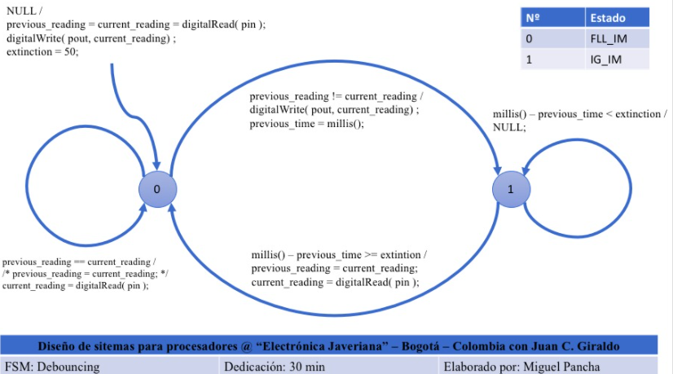
DEBOUNCING Diagrams

Slide 6
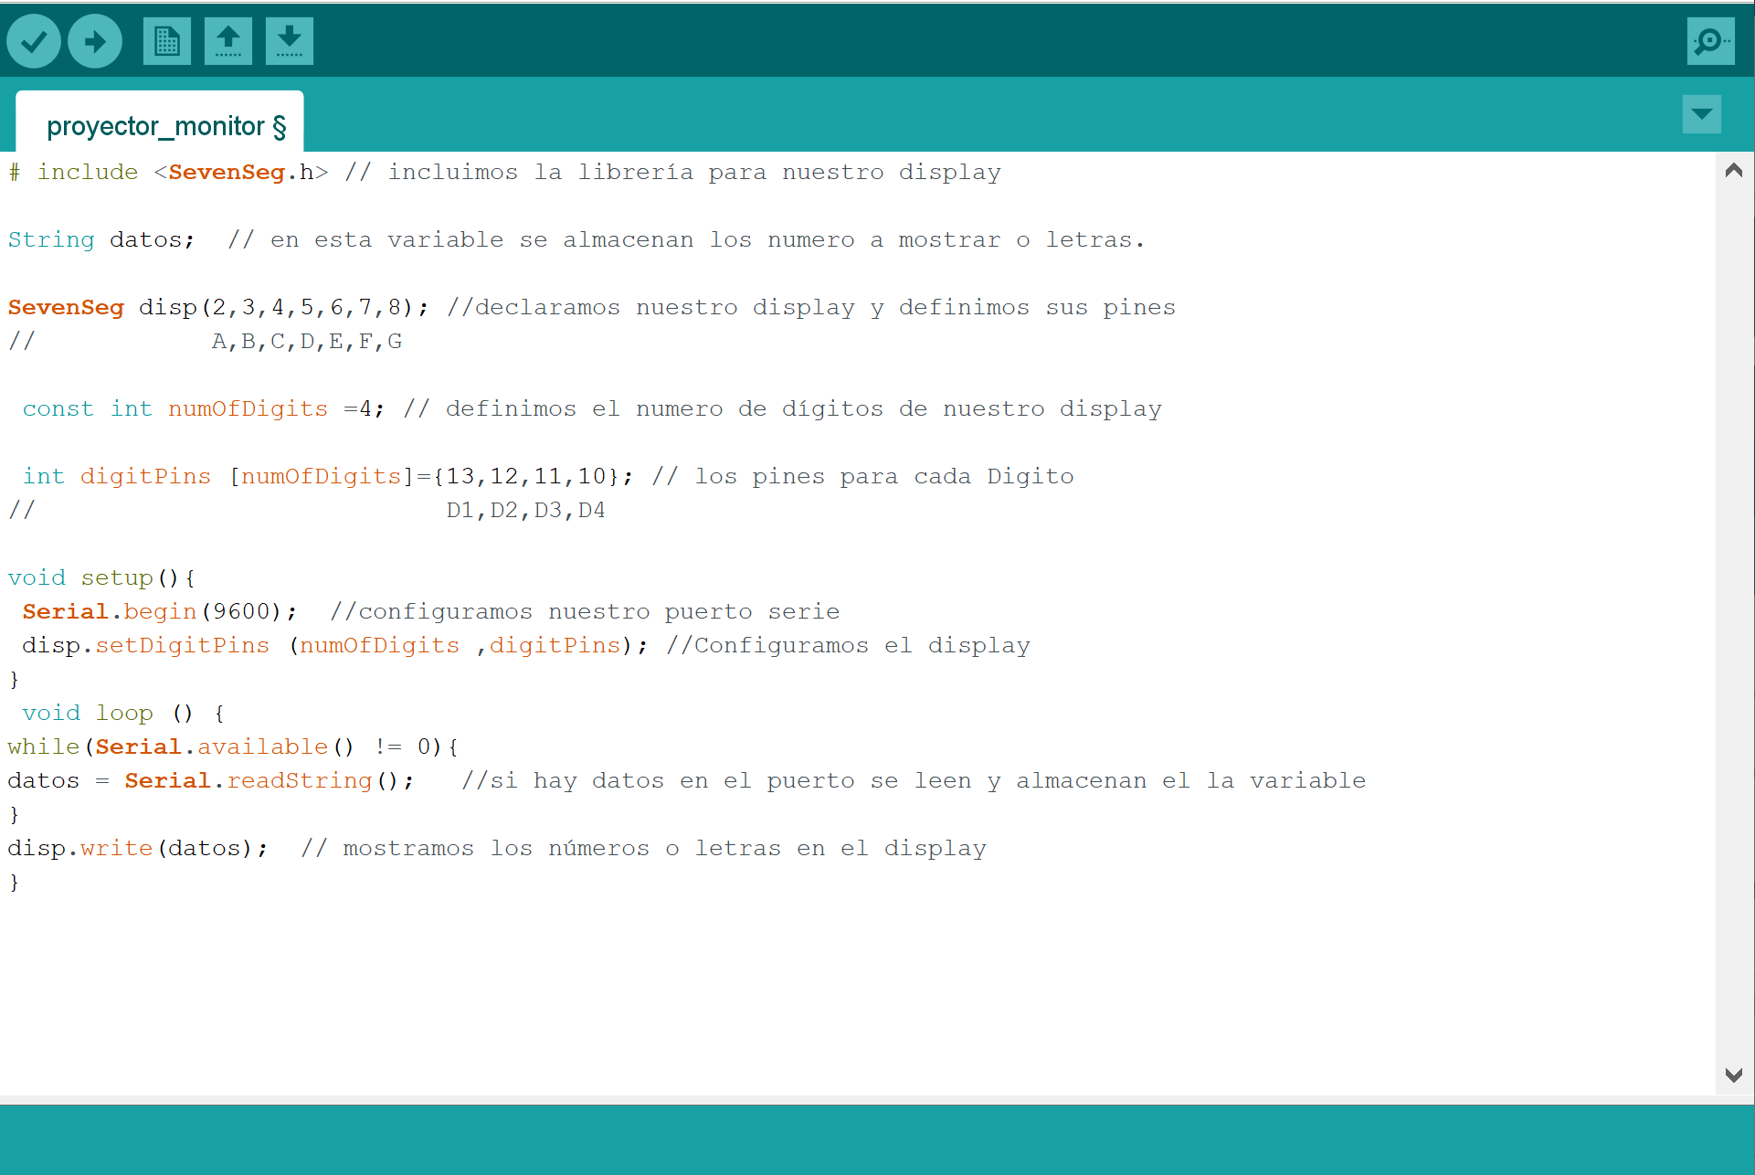
arduino code (Display)

Slide 7
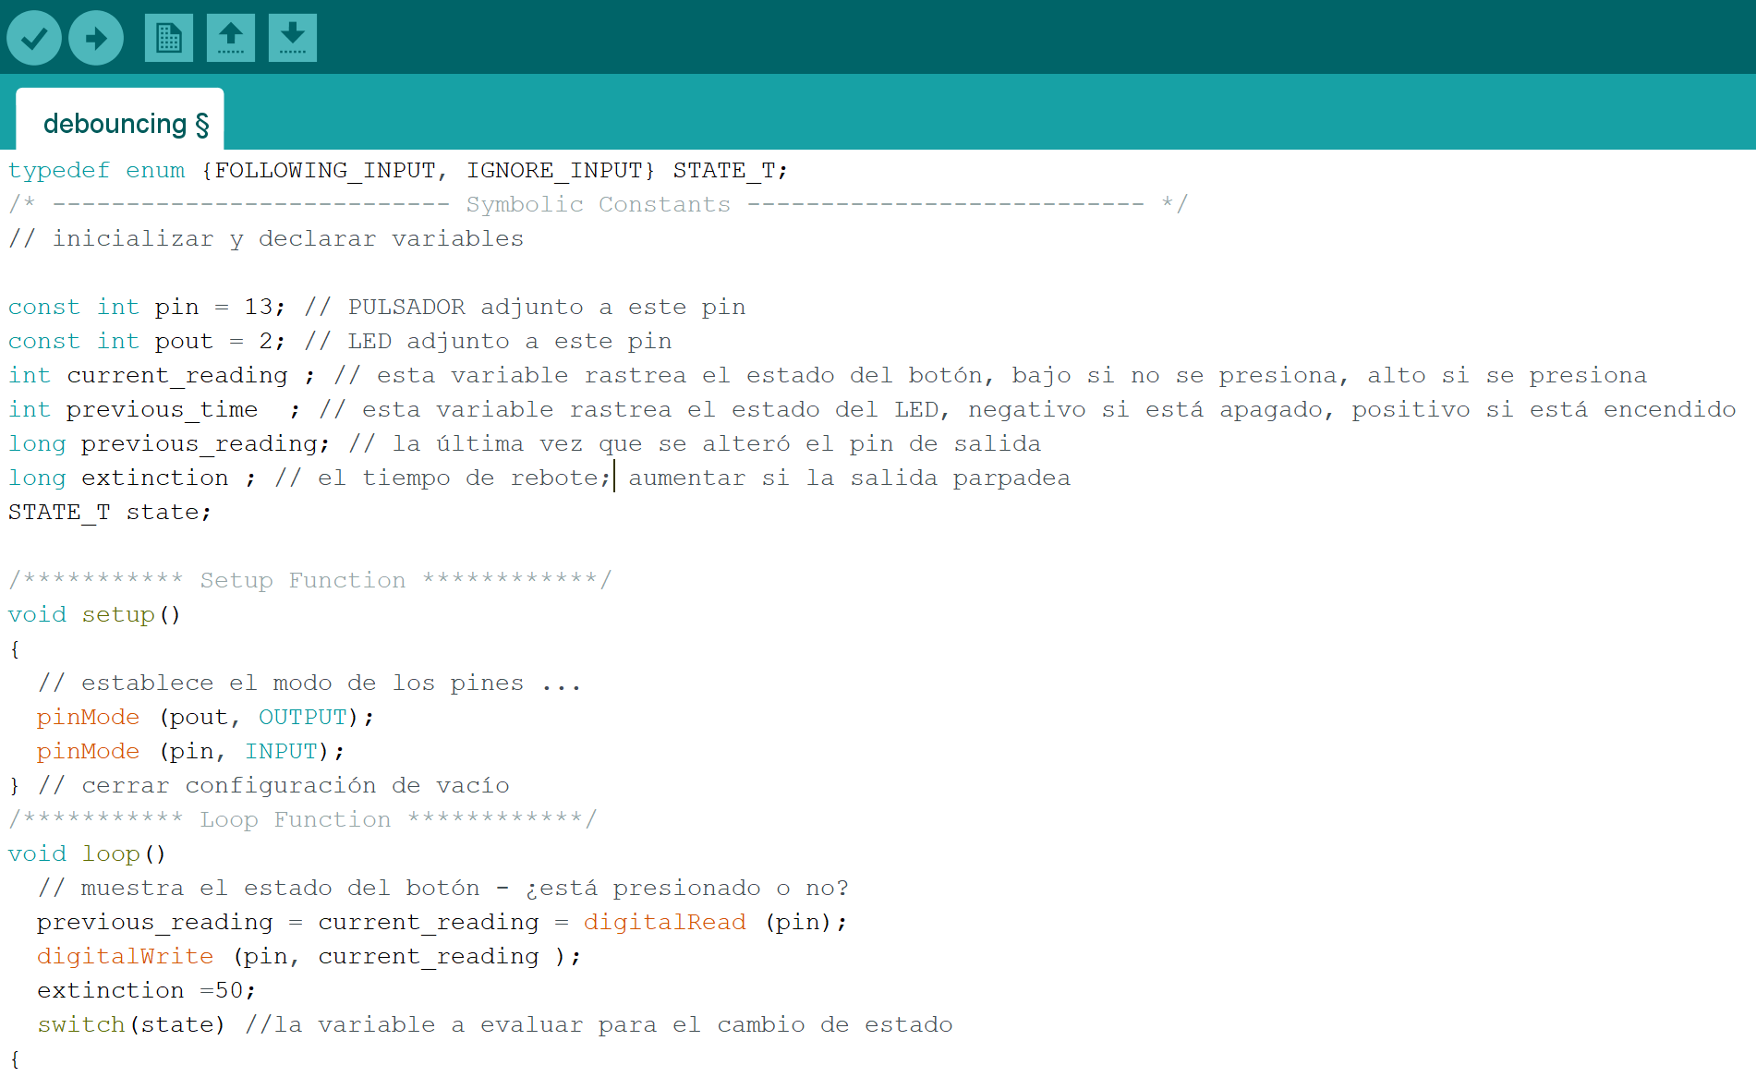
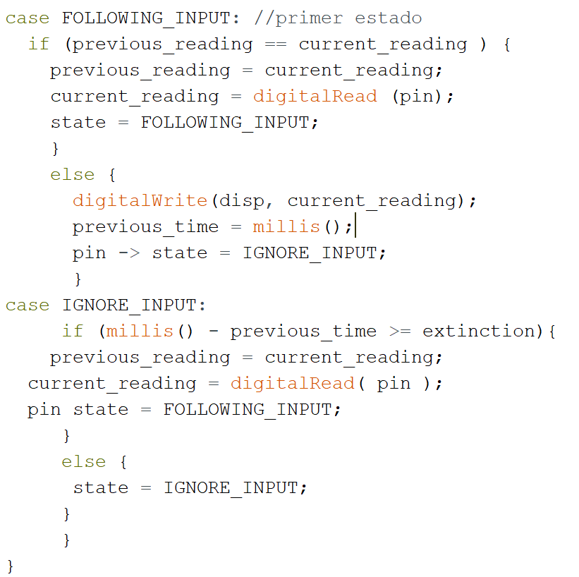
arduino code (Debouncing)

Slide 8
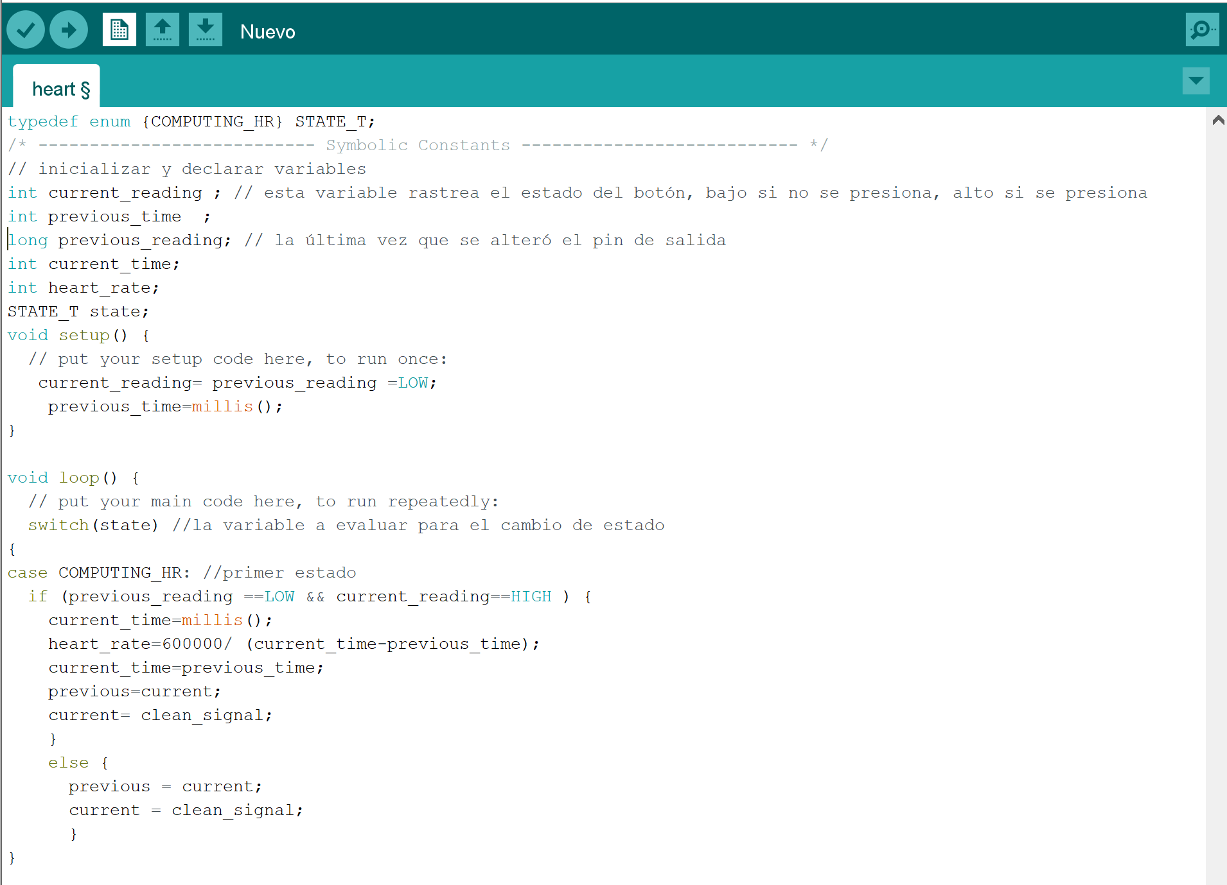
arduino code (heart monitor)

Slide 9
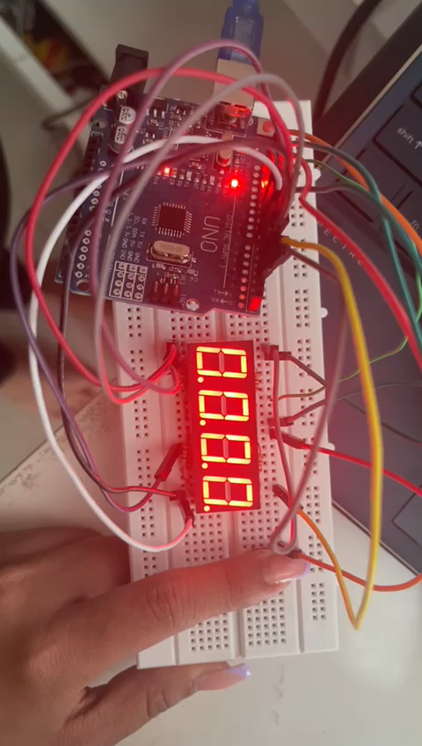
implementation

